Slide 1

Snipe Team
29 December 2017
www.snipe.co.in
1
Notes:
1

Slide 2



Slide 3
Contents
Modules of spring
Different types of framework
IoC (inversion of Control)
Dependency injection in spring
AOP
Spring JDBC template
Spring ORM framework
Spring & Hibernate integration
Spring Bean autowiring
Spring MVC
Spring MVC validation

Slide 4
What is Spring ?
Spring is a lightweight framework .
It is also said as framework of framework because it provide support to various framework.
Example Struts, Hibernate, EJB, etc….
What is Framework ?
It is defined as structure where we find solution for various technical problems.
It was developed by Rod Johnson in 2003

Slide 5
Modules of Spring
Modules Of Spring
It consist of several modules.
IoC (Inversion Of Control)
AOP (Aspect Oriented
DAO (Data Access Object)
ORM (Object Relation Mapping)
Web MVC…..Etc

Slide 6
Different Types Of Framework
Spring framework
Spring ORM
Spring MVC
Hibernate
Vaadin framework
Hadoop framework
Google web framework

Slide 7
IoC(Inversion of Control)
These are the design pattern that is use to remove Dependency from the code.
IoC is achieved through dependency injection.
What is Dependency Injection?
It is a design pattern use to define object dependency between each other.
It exists in two type
Setter injection.
Constructor injection

Slide 8
Example Of IoC
Example of IoC
Example of IoC without Dependency
class Employee{
Address address;
Employee(){
address=new Address();
}
}
Example of IoC with Dependency
class Employee{
Address address;
Employee(Address address){
this.address=address;
}
}

Slide 9
IoC Container
The IoC container is responsible to instantiate, configure and assemble the objects. The IoC container gets information's from the XML file and works accordingly. The main tasks performed by IoC container are:
to instantiate the application class
to configure the object
to assemble the dependencies between the objects
There are two types of IoC containers. They are:
BeanFactory
ApplicationContext

Slide 10
Spring - Bean
The objects that form the backbone of your application and that are managed by the Spring IoC container are called beans. A bean is an object that is instantiated, assembled, and otherwise managed by a Spring IoC container. These beans are created with the configuration metadata that you supply to the container.
Bean definition contains the information called configuration metadata, which is needed for the container to know the following −
How to create a bean
Bean's lifecycle details
Bean's dependencies

Slide 11
Spring - Bean Life Cycle
The life cycle of a Spring bean is easy to understand. When a bean is instantiated, it may be required to perform some initialization to get it into a usable state. Similarly, when the bean is no longer required and is removed from the container, some cleanup may be required.
only two important bean life cycle callback methods, which are required at the time of bean initialization and its destruction.
To define setup and teardown for a bean, we simply declare the <bean> with initmethod and/or destroy-method parameters.

Slide 12
Spring Bean Initialization callbacks
The org.springframework.beans.factory.InitializingBean interface specifies a single method −
void afterPropertiesSet() throws Exception;
Thus, you can simply implement the above interface and initialization work can be done inside afterPropertiesSet() method as follows −
public class ExampleBean implements InitializingBean {
public void afterPropertiesSet() {
// do some initialization work
}
}
In the case of XML-based configuration metadata, you can use the init-method attribute to specify the name of the method that has a void no-argument signature. For example −
<bean id = "exampleBean" class = "examples.ExampleBean" init-method = "init"/>
Following is the class definition −
public class ExampleBean {
public void init() {
// do some initialization work
}

Slide 13
Spring Bean Destruction callbacks
The org.springframework.beans.factory.DisposableBean interface specifies a single method −
void destroy() throws Exception;
Thus, you can simply implement the above interface and finalization work can be done inside destroy() method as follows −
public class ExampleBean implements DisposableBean {
public void destroy() {
// do some destruction work
}
}
In the case of XML-based configuration metadata, you can use the destroy-method attribute to specify the name of the method that has a void no-argument signature. For example −
<bean id = "exampleBean" class = "examples.ExampleBean" destroy-method = "destroy"/>
Following is the class definition −
public class ExampleBean {
public void destroy() {
// do some destruction work
} }

Slide 14
Inheriting Bean in Spring
By using the parent attribute of bean, we can specify the inheritance relation between the beans. In such case, parent bean values will be inherited to the current bean.
A child bean definition inherits configuration data from a parent definition. The child definition can override some values, or add others, as needed.
When you use XML-based configuration metadata, you indicate a child bean definition by using the parent attribute, specifying the parent bean as the value of this attribute.

Slide 15
Spring - Bean Inheritance With Example
File: HelloWorld
public class HelloWorld {
private String message1;
private String message2;
public void setMessage1(String message) {
this.message1 = message;
}
public void setMessage2(String message)
{
this.message2 = message;
}
public void getMessage1(){
System.out.println("World Message1 : " + message1);
}
public void getMessage2(){
System.out.println("World Message2 : " + message2);
}
}

Slide 16
Spring - Bean Inheritance With Example
File: HelloIndia
public class HelloIndia {
private String message1;
private String message2;
private String message3;
public void setMessage1(String message){ this.message1 = message;
}
public void setMessage2(String message){ this.message2 = message;
}
public void setMessage3(String message){ this.message3 = message;
}
public void getMessage1() {
System.out.println("India Message1 : " + message1);
}
public void getMessage2(){
System.out.println("India Message2 : " + message2);
}
public void getMessage3(){
System.out.println("India Message3 : " + message3);
}
}

Slide 17
Spring - Bean Inheritance With Example
File:Beans.xml
<?xml version = "1.0" encoding = "UTF-8"?>
<beans xmlns = "http://www.springframework.org/schema/beans" xmlns:xsi = "http://www.w3.org/2001/XMLSchema-instance" xsi:schemaLocation = "http://www.springframework.org/schema/beans http://www.springframework.org/schema/beans/spring-beans-3.0.xsd">
<bean id = "helloWorld" class = "com.tutorialspoint.HelloWorld">
<property name = "message1" value = "Hello World!"/> <property name = "message2" value = "Hello Second World!"/>
</bean> <bean id =" helloIndia" class = "com.tutorialspoint.HelloIndia" parent = "helloWorld">
<property name = "message1" value = "Hello India!"/>
<property name = "message3" value = "Namaste India!"/>
</bean>
</beans>

Slide 18
Spring - Bean Inheritance With Example
File: MainApp
public class MainApp {
public static void main(String[] args) {
ApplicationContext context = new ClassPathXmlApplicationContext("Beans.xml"); HelloWorld objA = (HelloWorld) context.getBean("helloWorld"); objA.getMessage1();
objA.getMessage2();
HelloIndia objB = (HelloIndia) context.getBean("helloIndia"); objB.getMessage1();
objB.getMessage2();
objB.getMessage3();
}
}
Output
World Message1 : Hello World! World
Message2 : Hello Second World! India
Message1 : Hello India! India
Message2 : Hello Second World! India
Message3 : Namaste India!

Slide 19
Dependency Injection In Spring
When our class object need to get any private values or it need to access any other class object or it may need any collection type to access then some external person will provide the required things to our class object.
In spring framework here one external person who will provide all the required thing to our spring bean class is the spring IoC container.
Types of Dependency injections:
Setter injection
Constructer injection.

Slide 20
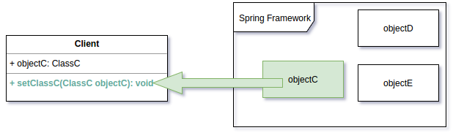
Spring Setter Injection
Setter Injection in Spring is a type of dependency injection in which the framework injects the dependent objects into the client using a setter method.

Slide 21

Example of Setter Injection in Spring
In typical software development, classes collaborate with each other to achieve a desired functionality. e.g. In an ATM (Automated Teller Machine) system, the ATM class and Printer class can collaborate with each other to print the balance information for a bank account.
<bean id="atm" class="com.studytrails.tutorials.springsetterinjection.ATM"> <property name="printer" ref="printer" /> </bean>
<bean id="printer" class="com.studytrails.tutorials.springsetterinjection.Printer"> </bean>

Slide 22
Different types of Setter Injection
Setter injection with dependent objects.
Setter injection with collection
In collection we have
Set
List
Map
Object dependency :While constructing spring beans if one spring bean dependent on another spring bean class for performing some logic, this process of dependency is called object dependency.

Slide 23
Example of Setter Injection
while creating spring bean(POJO class) the bean class can use any of following 3 type of collection as dependency.
1 Set
2 List
3 Map
File Name: Question.java
Public class Question {
Private int id;
Private String name;
Private List<String>answers;
// Setter And Getter method
Public void dosplayInfo() {
System.out.println(id+ “ ” +name);
System.out.println(“answers are”);
}
}

Slide 24
Example of Setter Injection With Xml File
ApplicationContext.xml
<bean id=”q” class=”com.javatpoint.Question”>
<property name=”id” value=”1”> </property>
<property name=”name” value=”What is java”> </property>
<list>
<value>java is a programming Language</value>
<value>Java is a plotform</value>
<value>open source</value>
</list>
</property>
</bean>
</beans>

Slide 25
Example of Setter Injection With Test Class
Test.java
Public class Test {
Public static void main(String[] args) {
Resource r=new ClassPathResource(“ApplicationContext.xml”);
BeanFactory factory=new XmlBaenFactory(r);
Question q=(Question)factory.getBean(“q”);
q.displayInfo();
}
}

Slide 26
Constructor Injection In Spring
In spring config xml we need to inform to the spring IoC about constructor injection by using <constructer-arg/>.
In spring bean class if both constructer and setter injection applied for same property then constructor injection will be overridden by setter injection, because constructor injection will happen at the object creation time and setter after objection right so setter will overrides.

Slide 27
Constructor Injection In Spring
We can inject the dependency by constructor. The <constructor-arg> subelement of <bean> is used for constructor injection. Here we are going to inject
primitive and String-based values
Dependent object (contained object)
Collection values.
In collection we can inject values by collection values
1. List
2. Set
3. Map

Slide 28
Example of Constructor Injection
File name: Employee.java
public class Employee {
private int id;
private String name;
public Employee() {System.out.println("def cons");}
public Employee(int id) {this.id = id;}
public Employee(String name) { this.name = name;}
public Employee(int id, String name) {
this.id = id;
this.name = name;
}
void show(){
System.out.println(id+" "+name);
}
}

Slide 29
Example of Constructor Injection
applicationContext.xml
<?xml version="1.0" encoding="UTF-8"?>
<beans
xmlns="http://www.springframework.org/schema/beans"
xmlns:xsi="http://www.w3.org/2001/XMLSchema-instance"
xmlns:p="http://www.springframework.org/schema/p"
xsi:schemaLocation="http://www.springframework.org/schema/beans
http://www.springframework.org/schema/beans/spring-beans-3.0.xsd">
<bean id="e" class="com.javatpoint.Employee">
<constructor-arg value="10" type="int"></constructor-arg>
</bean>
</beans>

Slide 30
Example of Constructor Injection With Main Class
File name:Test.java
import org.springframework.beans.factory.BeanFactory;
import org.springframework.beans.factory.xml.XmlBeanFactory;
import org.springframework.core.io.*;
public class Test {
public static void main(String[] args) {
Resource r=new ClassPathResource("applicationContext.xml"); BeanFactory factory=new XmlBeanFactory(r);
Employee s=(Employee)factory.getBean("e");
s.show();
}
}
Output:10 null

Slide 31
Diff B/w Setter & Constructer Injection in Spring
Setter Injection
In setter injection partial injection of dependencies can possible.
Setter injection will overrides the constructor injection value provided if we write setter & constructor for the same property.
Setter injection makes bean class object as mutable
Constructer Injection
In constructer injection partial injection of dependencies can not possible.
In constructer injection can not overrides the setter injection values

Slide 32
Aspect oriented programming (AOP)
Why use AOP?
It provide the pluggable way to dynomically add the additional concern before, around or after the actual logic.
Where use AOP?
To provide declarative enterprise service such as declarative transaction management, and It allows users to implement customer aspects.

Slide 33
AOP Annotation
Spring AOP Aspects Annotation.
In spring framework recommends you to use spring aspectJ AOP implementation over the spring 1.2 old style dtd based AOP.
There are two way to use AOP AspectJ implementation.
By annotation
By XML configuration(schema based)
Spring aspectJ AOP implementation provide many annotations
@Aspect : declares the class as aspect
@Pointcut :declares the pointcut expression.

Slide 34
Different types AOP Annotation
@Before :declare the before advice. It is applied before calling actual method.
@After : It is applied after calling the actual method.
@After Returning : Declare after the returning advice. It is used after calling the actual method.
@Around: Declare the around advice it is applied before and after calling actual method.
@After Throwing:Decleares the throws advice. It is applied if actual method throws exception.

Slide 35
AOP with Example
Operation.java
Public class Operation{
Public void msg() {
System.out.println(“Msg method invoked”);
}
Public void m() {
System.out.println(“m method invoked”);
return 2; }
Public void k() {
System.out.println(“k method invoked”);
return 3; }
}

Slide 36
AOP with Example
TrackOperation.java
@Aspect
Public class TrackOperation {
@pointcut(“execution (* operation .*(…))”)
Public void k() { }
@Before (“k()”)
Public void myadvice(joinpoint jp)
{
System.out.println(“additional concern”);
// System.out.println(“method signature;” +jp.getSignatur());
}
}

Slide 37
AOP with XML File
AOP with XML File
ApplicationContext.xml
<?xml version=”1.0” encoding=”UTF-8?”>
<bean id =”opBean” class=”com.javatpoint.Opertion”> </bean>
<bean class = “orgspringframework.ao[.aspectj.annotation.AnnotationAwareASpectAutoProxyCreattor”> </bean>
</beans>

Slide 38
AOP with Main Class
Test.java
Public class Test {
ApplicationContext context=new ClassPathXmlApplicationContext(“applicationContext.xml”);
Operatin c=(operation) context.getBean(“opBean”);
System.out.println(“calling msg…”);
e.msg();
System.out.println(“calling m…..”)
e.m();
System.out.println(“calling k….”)
e.k();
}
}

Slide 39
AOP with Output
Output:
Calling msg……
Additional concern
Msg() method invoked
Calling m…
Additional concern
Calling k…..
Additional concern
K() method invoked.
In the above output Additional concern is printed before msg(), m() and k() method is invoked.

Slide 40
Spring JDBC Template
Spring JDBC templete is a powerful mechanism to connect to the database and execute SQL queries.
It internally uses JDBC API but eliminate a lot of problem of JDBC API
In spring we need to configure the following properties to obtain connection with database.
<bean id =”id1” class=”org.springframework.datasource.DriverManagerDataSource”>
<property name=”driverClassName” value=” ”/>
<property name=”url” value=” ” />
<property name=”username” value=” ” />
<property name=”password” value=” ” />
</bean>

Slide 41
Spring JdbcTemplate Class
The JDBC Template class executes SQL queries, updates statements, stores procedure calls, performs iteration over ResultSets, and extracts returned parameter values. It also catches JDBC exceptions and translates them to the generic, more informative, exception hierarchy defined in the org.springframework.dao package.
Instances of the JdbcTemplate class are threadsafe once configured. So you can configure a single instance of a JdbcTemplate and then safely inject this shared reference into multiple DAOs.
A common practice when using the JDBC Template class is to configure a DataSource in your Spring configuration file, and then dependency-inject that shared DataSource bean into your DAO classes, and the JdbcTemplate is created in the setter for the DataSource.

Slide 42
Spring Data Access Object (DAO)
DAO stands for Data Access Object, which is commonly used for database interaction. DAOs exist to provide a means to read and write data to the database and they should expose this functionality through an interface by which the rest of the application will access them.
The DAO support in Spring makes it easy to work with data access technologies like JDBC, Hibernate, JPA, or JDO in a consistent way.
we can perform CRUD (Create, Read, Update and Delete) operation on database tables using SQL and JDBC Template object

Slide 43
Spring - Transaction Management
A database transaction is a sequence of actions that are treated as a single unit of work. These actions should either complete entirely or take no effect at all. Transaction management is an important part of RDBMS-oriented enterprise application to ensure data integrity and consistency. The concept of transactions can be described with the following four key properties described as ACID −
Atomicity − A transaction should be treated as a single unit of operation, which means either the entire sequence of operations is successful or unsuccessful.
Consistency − This represents the consistency of the referential integrity of the database, unique primary keys in tables, etc.
Isolation − There may be many transaction processing with the same data set at the same time. Each transaction should be isolated from others to prevent data corruption.
Durability − Once a transaction has completed, the results of this transaction have to be made permanent and cannot be erased from the database due to system failure.

Slide 44
Local vs. Global Transactions
Local transactions are specific to a single transactional resource like a JDBC connection, whereas global transactions can span multiple transactional resources like transaction in a distributed system.
Local transactions are easier to be implemented.
Global transaction management is required in a distributed computing environment where all the resources are distributed across multiple systems. In such a case, transaction management needs to be done both at local and global levels. A distributed or a global transaction is executed across multiple

Slide 45
Programmatic vs. Declarative Transaction in Spring
Spring supports two types of transaction management −
Programmatic transaction management − This means that you have to manage the transaction with the help of programming. That gives you extreme flexibility, but it is difficult to maintain.
Declarative transaction management − This means you separate transaction management from the business code. You only use annotations or XML-based configuration to manage the transactions.
Declarative transaction management is preferable over programmatic transaction management though it is less flexible than programmatic transaction management, which allows you to control transactions through your code. But as a kind of crosscutting concern, declarative transaction management can be modularized with the AOP approach.

Slide 46
Method in Spring JDBC
Public int update(String query)
public int update(string query, object..args)
public void execute(String query)
public T execute(String sql,
prepared StatementCallback action)
public T query(String sql, ResultSetExtracter res)
public List query(String sql, RowMapper res)

Slide 47
Example of Spring Jdbc
create table employee(
id number(10),
name varchar2(100),
salary number(10)
);
Employee.java
public class Employee {
private int id;
private String name;
private float salary;
//getters and setters
}

Slide 48
EmployeeDao.java
public class EmployeeDao {
private JdbcTemplate jdbcTemplate;
public void setJdbcTemplate(JdbcTemplate jdbcTemplate) {
this.jdbcTemplate = jdbcTemplate;
}
public int saveEmployee(Employee e){
String query="insert into employee values(
'"+e.getId()+"','"+e.getName()+"','"+e.getSalary()+"')";
return jdbcTemplate.update(query);
}
public int updateEmployee(Employee e){
String query="update employee set
name='"+e.getName()+"',salary='"+e.getSalary()+"' where id='"+e.getId()+"' "; return jdbcTemplate.update(query);
}
public int deleteEmployee(Employee e){
String query="delete from employee where id='"+e.getId()+"' ";
return jdbcTemplate.update(query);
}
}

Slide 49
ApplicationContext.xml
<?xml version="1.0" encoding="UTF-8"?>
<beans
<bean id="ds" class="org.springframework.jdbc.datasource.DriverManagerDataSource">
<property name="driverClassName" value="oracle.jdbc.driver.OracleDriver" />
<property name="url" value="jdbc:oracle:thin:@localhost:1521:xe" />
<property name="username" value="system" />
<property name="password" value="oracle" />
</bean>
<bean id="jdbcTemplate" class="org.springframework.jdbc.core.JdbcTemplate">
<property name="dataSource" ref="ds"></property>
</bean>
<bean id="edao" class="com.javatpoint.EmployeeDao">
<property name="jdbcTemplate" ref="jdbcTemplate"></property>
</bean>
</beans>

Slide 50
Test.java
public class Test {
public static void main(String[] args) {
ApplicationContext ctx=new ClassPathXmlApplicationContext("applicationContext.xml");
EmployeeDao dao=(EmployeeDao)ctx.getBean("edao");
int status=dao.saveEmployee(new Employee(102,"Amit",35000));
System.out.println(status);
}
}

Slide 51
Spring with ORM Frameworks
Spring provides API to easily integrate spring with ORM framework such as Hibernate, JPA(Java Persistence API), JDO(Java DATA Objects).
Advantage of ORM Framework
1 Less coding is required.
2 Easy to test.
3 Better exception handling.
4 Integrated transaction management

Slide 52
Hibernate and Spring Integration
We can simple integrate hibernate application with spring application.
In hibernate framework we provide all the database information on hibernate.cfg.xml file.
But we are going to integrate the hibernate application with spring we don’t need to create the hibernate .cfg.xml file. We can provide all the information in the application.xml file.

Slide 53
Advantage of spring framework with hibernate
The spring framework provide hibernate template class so we need to follow so many steps like creating configuration , Build Session Factory, Session, beginning and committing transaction.
Hibernate 3 throws Runtime exceptions unlike checked exceptions thrown in the previous releases. Spring can translate these exceptions into SpringDAO exceptions and map them into Spring DAO exception hierarchy. But you have to use one of the following to get this 1. Use HibernateTemplate 2. @Repository

Slide 54
Spring Data JPA
Spring data JPA API provides JPA Template class to integrate spring application with JPA.
JPA is the sun specification for persisting objects in enterprise application. It is currently used as the replacement for complex entity beans.
Advantage:
No need to write before and after code for persisting update, deleting or searching object such as creating persistence instance, creating Entity ManagerFactory instance, creating entity Transaction instance, creating Entity Manager instance, committing EntityTransation instance and closing EntityManager.

Slide 55
Spring Bean Autowiring
Wiring a bean means configuring a bean along with its dependency into an XML file by default Autowiring is disable in spring framework.
It means the programmer has to explicitly wire the bean properties into XML file.
If Autowiring is enable then spring container will take care about injecting the dependencies programmer no need to configure into an XML file explicitly.
Autowiring is only supported if the dependencies are in the form of object.

Slide 56
Different types of Autowirings
To enable Autowiring we should add autowire attribute to the bean element or bean tag.
1 byNAme
2 byType
3 Construtor
4 autoDetect
5 none

Slide 57
Example of Autowiring byname
File: Book.java
Public class Book {
Private String bookname;
Private int bookprice;
// Setter & getter method
}
}
File name: Categeries.java
Public class Categories {
Private String name;
Private Book bk;
// setter & getter method
Public void show()
{
System.out.println(“Categories name:” + name);
System.out.println(“Book name” +getBookname() +” and BookPrice:” + bk.getBookPrice()); } }

Slide 58
Example of Autowiring byname
File: ClientLogic .java
Public class ClientLogic {
Public static void main(String[] args)
{
Resource res=new ClassPathResource(“spconfig.xml”);
BeanFactory factory= new XmlBeanFactory(res);
Object o=factory.getBean(“id1”);
Categories wb=(categories) o;
wb.show();
}
}

Slide 59
Example of Autowiring byname
SPConfig.xml
<beans>
<bean id=”id1” class=”java4s.categories” autowire=”byName”>
<property name=”name” value=”General Books”/>
</bean>
<bean id=”bk” class=”java4s.Book”>
<property name=”bookname” value=”The kids”/>
<property name=”bookprice” value=”500”/>
</bean>
</beans>
Output: name: General Book
Book name: the kids and book price :500.

Slide 60
Limitations with autowiring In Spring
Autowiring works best when it is used consistently across a project. If autowiring is not used in general, it might be confusing for developers to use it to wire only one or two bean definitions. Though, autowiring can significantly reduce the need to specify properties or constructor arguments but you should consider the limitations and disadvantages of autowiring before using them.
Limitations & Description
1 Overriding possibility
You can still specify dependencies using <constructor-arg> and <property> settings which will always override autowiring.
2 Primitive data types
You cannot autowire so-called simple properties such as primitives, Strings, and Classes.
3 Confusing nature
Autowiring is less exact than explicit wiring, so if possible prefer using explict wiring.

Slide 61
Spring - Annotation Based Configuration
Starting from Spring 2.5 it became possible to configure the dependency injection using annotations. So instead of using XML to describe a bean wiring, you can move the bean configuration into the component class itself by using annotations on the relevant class, method, or field declaration.
Annotation injection is performed before XML injection. Thus, the latter configuration will override the former for properties wired through both approaches.
<?xml version = "1.0" encoding = "UTF-8"?>
<beans xmlns = "http://www.springframework.org/schema/beans" xmlns:xsi = "http://www.w3.org/2001/XMLSchema-instance" xmlns:context = "http://www.springframework.org/schema/context" xsi:schemaLocation = "http://www.springframework.org/schema/beans http://www.springframework.org/schema/beans/spring-beans-3.0.xsd http://www.springframework.org/schema/context http://www.springframework.org/schema/context/spring-context-3.0.xsd">
<context:annotation-config/>
<!-- bean definitions go here -->
</beans>

Slide 62
Spring - MVC Framework
The Spring Web MVC framework provides Model-View-Controller (MVC) architecture and ready components that can be used to develop flexible and loosely coupled web applications. The MVC pattern results in separating the different aspects of the application (input logic, business logic, and UI logic), while providing a loose coupling between these elements.
The Model encapsulates the application data and in general they will consist of POJO.
The View is responsible for rendering the model data and in general it generates HTML output that the client's browser can interpret.
The Controller is responsible for processing user requests and building an appropriate model and passes it to the view for rendering.

Slide 63
Spring MVC
Spring MVC provides an elegant solution to use MVC in spring framework by help of DispatcherServlet.
In spring web MVC DispatchServlet class work as the front controller. It is responsible to manage the flow of the spring MVC application.
The @Controller annotation is used to make the class as the controller in spring 3.
@RequestMapping annotation is used to map the request url. It is applied on the method.

Slide 64
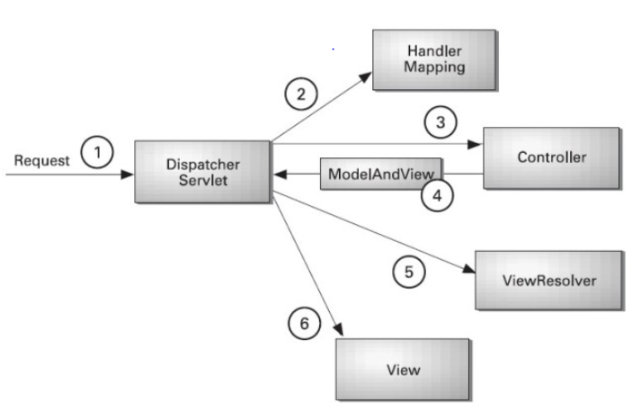
Flow of Spring Web MVC
As displayed in the figure, all the incoming request is intercepted by the DispatcherServlet that works as the front controller. The DispatcherServlet gets entry of handler mapping from the xml file and forwards the request to the controller. The controller returns an object of ModelAndView. The DispatcherServlet checks the entry of view resolver in the xml file and invokes the specified view component.

Slide 65
Spring MVC validations
In spring there is no 100% best way to perform the validation.
Spring provide 3 types of validations
1 Annotation validations
2 Manual Validations
3 mix of manual and Annotation.
Spring annotation validation are known as JSR-303 validation.

Slide 66
Advantage of Spring
1) Predefined Templates
2) Loose Coupling
3) Easy to test
4) Lightweight
5) Fast Development
6) Powerful abstraction
7) Declarative support

Slide 67
Spring Boot

Slide 68
Spring Boot
Spring Boot is a Spring module which provides RAD (Rapid Application Development) feature to Spring framework.
It is used to create stand alone spring based application that you can just run because it needs very little spring configuration.
Spring Boot does not generate code and there is absolutely no requirement for XML configuration.
It uses convention over configuration software design paradigm that means it decrease the effort of developer.

Slide 69
Advantages of Spring Boot
Create stand-alone Spring applications that can be started using java -jar.
Embed Tomcat, Jetty or Undertow directly. You don't need to deploy WAR files.
It provides opinionated 'starter' POMs to simplify your Maven configuration.
It automatically configure Spring whenever possible.
It provides production-ready features such as metrics, health checks and externalized configuration.
Absolutely no code generation and no requirement for XML configuration.

Slide 70
Spring Boot Features
Web Development
It is well suited Spring module for web application development. We can easily create a self-contained HTTP server using embedded Tomcat, Jetty or Undertow. We can use the spring-boot- starter-web module to start and running application quickly.
2. SpringApplication
It is a class which provides the convenient way to bootstrap a spring application which can be started from main method. You can call start your application just by calling a static run() method.
public static void main(String[] args){
SpringApplication.run(className.class, args);
}

Slide 71
Spring Boot Features
Admin Support
Spring Boot provides the facility to enable admin related features for the application. It is used to access and manage application remotely. We can enable it by simply using spring.application.admin.enabled property.
Externalized Configuration
Spring Boot allows us to externalize our configuration so that we can work with the same application in different environments. Application use YAML files to externalize configuration.
Properties Files
Spring Boot provides rich set of Application Properties. So, we can use that in properties file of our project. Properties file is used to set properties like: server-port = 8082 and many others. It helps to organize application properties.

Slide 72
Spring Boot Features
YAML Support
It provides convenient way for specifying hierarchical configuration. It is a superset of JSON. The SpringApplication class automatically support YAML.
Type-safe Configuration
Strong type-safe configuration is provided to govern and validate the configuration of application. Application configuration is always a crucial task which should be type-safe. We can also use annotation provided by this library.
Logging
Spring Boot uses Common logging for all internal logging. Logging dependencies are managed by default. We should not change logging dependencies, if there is no required customization is needed.
Security
Spring Boot applications are spring bases web applications. So, it is secure by default with basic authentication on all HTTP endpoints.

Slide 73
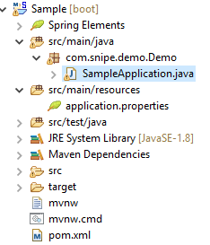
Spring Boot File Structure
Spring Boot File Structure

Slide 74
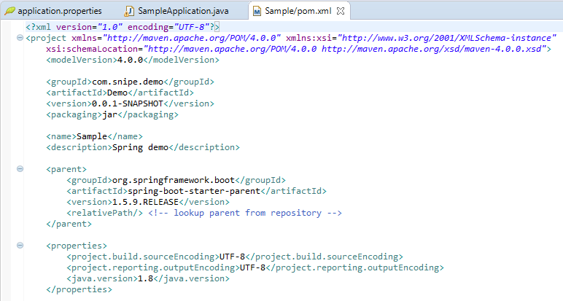
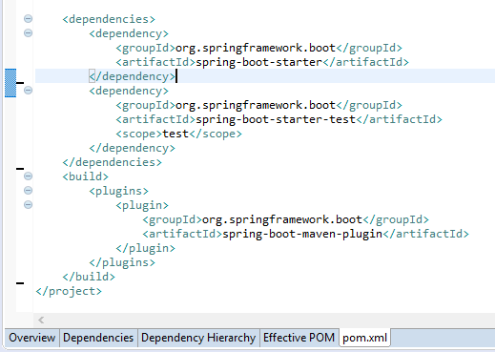
Spring Boot with XML File

Slide 75
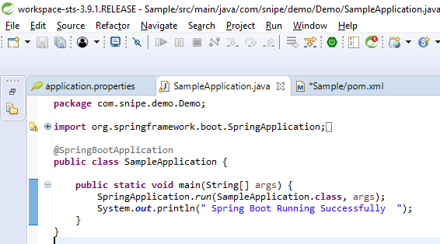
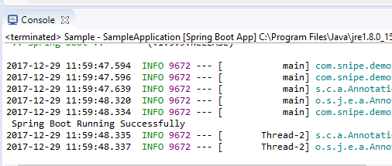
Spring Boot Simple Example
Spring Boot -SampleApplication.java
Spring Boot SampleApplication.java output

Slide 76
Spring Annotations
@RestController and @RequestMapping annotations
The @RestController is a stereotype annotation. It adds @Controller and @ResponseBody annotations to the class.
We need to import org.springframework.web.bind.annotation package in our file, in order to implement it.
The @RestController annotation informs to the Spring to render the result back to the caller.
The @RequestMapping annotation is used to provide routing information. It tells to the Spring that any HTTP request should map to the corresponding method. We need to import org.springframework.web.annotation package in our file.

Slide 77
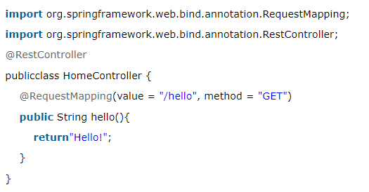
Spring Annotations With Example
@RequestMapping is one of the most widely used Spring MVC annotation. org.springframework.web.bind.annotation.RequestMapping annotation is used to map web requests onto specific handler classes and/or handler methods. @RequestMapping can be applied to the controller class as well as methods. It shown in the below Example.

Slide 78
Spring Boot Dependency Management
Spring Boot manages dependencies and configuration automatically. You don't need to specify version for any of that dependencies.
Spring Boot upgrades all dependencies automatically when you upgrade Spring Boot.
We can include Maven plugin in our pom.xml file. It is used to package the project as an executable jar. We are adding it here.
<build>
<plugins>
<plugin>
<groupId>org.springframework.boot</groupId>
<artifactId>spring-boot-maven-plugin</artifactId>
</plugin>
</plugins>
</build>

Slide 79
Inheriting the starter parent & Changing Java version
We can configure our project to inherit from the spring-boot-starter-parent by simply setting as below.
<parent>
<groupId>org.springframework.boot</groupId>
<artifactId>spring-boot-starter-parent</artifactId>
<version>2.0.0.BUILD-SNAPSHOT</version>
</parent>
Changing the Java version
we can easily set Java version for our project in the properties section as given below.
<properties>
<java.version>1.8</java.version>
</properties>

Slide 80
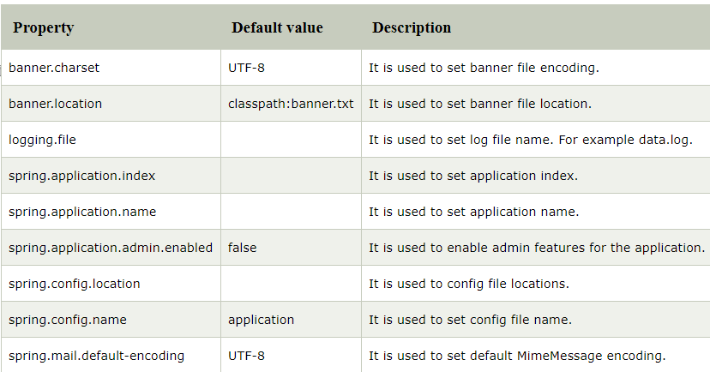
Spring Boot provides various properties which can be specified inside our project's application.properties file. These properties have default values and you can set that inside the properties file. Properties are used to set values like: server-port number, database connection configuration etc.
Some of the Properties

Slide 81
Spring Boot Starters
Starters are a set of convenient dependency descriptors which we can include in our application.
Spring Boot provides built-in starters which makes development easier and rapid. For example, if we want to get started using Spring and JPA for database access, just include the spring-boot-starter-data-jpa dependency in your project.
Starter should follow a naming pattern like: spring-boot-starter-*, where * is a particular type of application. This naming structure is intended to help when you need to find a starter.

Slide 82
Spring Boot Actuator
Spring Boot provides actuator to monitor and manage our application. Actuator is a tool which has HTTP endpoints. when application is pushed to production, you can choose to manage and monitor your application using HTTP endpoints.
To get production-ready features, we should use spring-boot-actuator module. We can enable this feature by adding it to the pom.xml file.
<dependencies>
<dependency>
<groupId>org.springframework.boot</groupId>
<artifactId>spring-boot-starter-actuator</artifactId>
</dependency>
</dependencies>

Slide 83
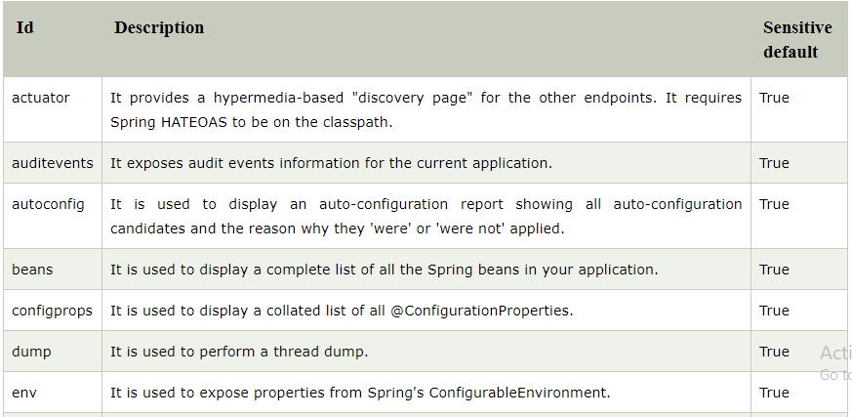
Spring Boot Endpoints
Actuator endpoints allow us to monitor and interact with our Spring Boot application. Spring Boot includes number of built-in endpoints and we can also add custom.
The following table contains the available endpoints.

Slide 84
Spring Boot Thymeleaf View
It is a server side Java template engine for web application. It's main goal is to bring elegant natural templates to your web application.
It can be integrate with Spring Framework and ideal for HTML5 Java web applications.
In the following example, we are using Thymeleaf as our HTML template and rendering it from controller.
In order to use Thymeleaf we must add it into our pom.xml file like:
<dependency>
<groupId>org.springframework.boot</groupId>
<artifactId>spring-boot-starter-thymeleaf</artifactId>
</dependency>

Slide 85
Spring Boot JDBC
Spring Boot provides starter and libraries for connecting to our application with JDBC.
In application.properties write the below code. Here we are using MySql.
spring.datasource.url=jdbc:mysql://localhost:3306/springbootdb
spring.datasource.username=root
spring.datasource.password=mysql
spring.jpa.hibernate.ddl-auto=create-drop

Slide 86
Spring Boot JDBC with Example
SpringBootJdbcApplication.java
import org.springframework.boot.SpringApplication;
import org.springframework.boot.autoconfigure.SpringBootApplication;
@SpringBootApplication
public class SpringBootJdbcApplication {
public static void main(String[] args) {
SpringApplication.run(SpringBootJdbcApplication.class, args);
}
}

Slide 87
Spring Boot JDBC With Example
Creating a controller to handle HTTP requests.
import org.springframework.web.bind.annotation.RequestMapping;
import org.springframework.beans.factory.annotation.Autowired;
import org.springframework.jdbc.core.JdbcTemplate;
import org.springframework.web.bind.annotation.RestController;
@RestController
Public class SpringBootJdbcController {
@Autowired
JdbcTemplate jdbc;
@RequestMapping("/insert")
public String index(){
jdbc.execute("insert into user(name,email)values('javatpoint','java@javatpoint.com')");
return"data inserted Successfully";
}
}

Slide 88
Spring Interview Questions
1) What is Spring?
2) What are the advantages of spring framework?
3) What are the modules of spring framework?
4) What is IOC and DI?
5) What is the role of IOC container in spring?
6) What are the types of IOC container in spring?
7) What is the difference between BeanFactory and ApplicationContext?
8) What is the difference between constructor injection and setter injection?
9) What is autowiring in spring? What are the autowiring modes?
10) What are the different bean scopes in spring?
11) In which scenario, you will use singleton and prototype scope?
12) What are the transaction management supports provided by spring?
13) What are the advantages of JdbcTemplate in spring?

Slide 89
Spring Interview Questions
14) What are classes for spring JDBC API?
15) How can you fetch records by spring JdbcTemplate?
16) What is the advantage of NamedParameterJdbcTemplate?
17) What is the advantage of SimpleJdbcTemplate?
18) What is AOP?
19) What are the advantages of spring AOP?
20) What are the AOP terminology?
21) What is JoinPoint?
22) Does spring framework support all JoinPoints?
23) What is Advice?
24) What are the types of advice in AOP?
25) What is Pointcut?
26) What is Aspect?
27) What is Introduction?
28) What is target object?
29) What is interceptor?

Slide 90
Spring Interview Questions
30) What is weaving?
31) Does spring perform weaving at compile time?
32) What are the AOP implementation?
33) What is the front controller class of Spring MVC?
34) What does @Controller annotation?
35) What does @RequestMapping annotation?
36) What does the ViewResolver class?
37) Which ViewResolver class is widely used?
38) Does spring MVC provide validation support?

Slide 91
Spring Boot Interview Questions
1) What is Spring Boot?
2) What are the advantages of Spring Boot?
3) What are the features of Spring Boot?
4) How to create Spring Boot application using Maven?
5) How to create Spring Boot project using Spring Initializer?
6) How to create Spring Boot project using boot CLI?
7) How to create simple Spring Boot application?
8) What are the Spring Boot Annotations?
9) What is Spring Boot dependency management?
10) What are the Spring Boot properties?

Slide 92
Spring Boot Interview Questions
11) What are the Spring Boot Starters?
12) What is Spring Boot Actuator?
13) What is thymeleaf?
14) How to use thymeleaf?
15) How to connect Spring Boot to the database using JPA?
16) How to connect Spring Boot application to database using JDBC?
17) What is @RestController annotation in Spring Boot?
18) What is @RequestMapping annotation in Spring Boot?
19) Spring Vs Spring Boot?

Slide 93
THANK YOU

